Slide 1
Online Pizza Ordering System

Slide 2
Team:
C.Narayana Swamy
Ram Mohan
Sathia Lakshmi
Indraneel
Thirumalaivasan

Slide 3
Project Introduction
Food ordering System is a web-based application developed with the help of Java programming language. It is mainly focused on receiving orders from the customer and delivering it to the vendor. This system helps in maintaining the user records and orders, more efficiently. Admin and customers all have a different interface and different privileges according to their needs.

Slide 4
Objectives
To develop an online system to help the users to order Food.
To manage orders for the restaurant effectively.
Admins can add food items by category and also update them, which will be reflected in the user page.
Shows the information and description related to the food items.
Adding and removing food items from the cart.
We can create an account as both admin and user.
Our application is secure and safe as the user details are encrypted in the data base

Slide 5
Requirements
Software Requirements
Windows version 7+.
Front-end : HTML & CSS, JS
Back-end : Oracle Database and Spring Boot
A browser which supports HTML & JavaScript.

Slide 6
Used Tools And Technologies
Frontend Used
HTML
CSS
JavaScript
BackEnd Used
Java
Spring Boot
Database(Oracle)

Slide 7
EXISTING SYSTEM
Time consuming process.
Records are maintained in registers.
Complicated to Edit, Update and Delete the data of the products and categories.
Required more man power.

Slide 8
Significance
• Easy to update information.
• Work becomes speedy.
• Access of any information individually.
• Decrease the load of the person involve in existing manual system.
• Well-designed reports.
• Easy & fast retrieval of information.
• Accuracy in work.
• It contains better storage capacity.
• Robust database back-end.
• Creating and changing data at ease.

Slide 9
Modules
Register Module.
Login Module.
User Module.
Shop Module.
Cart Module.

Slide 10
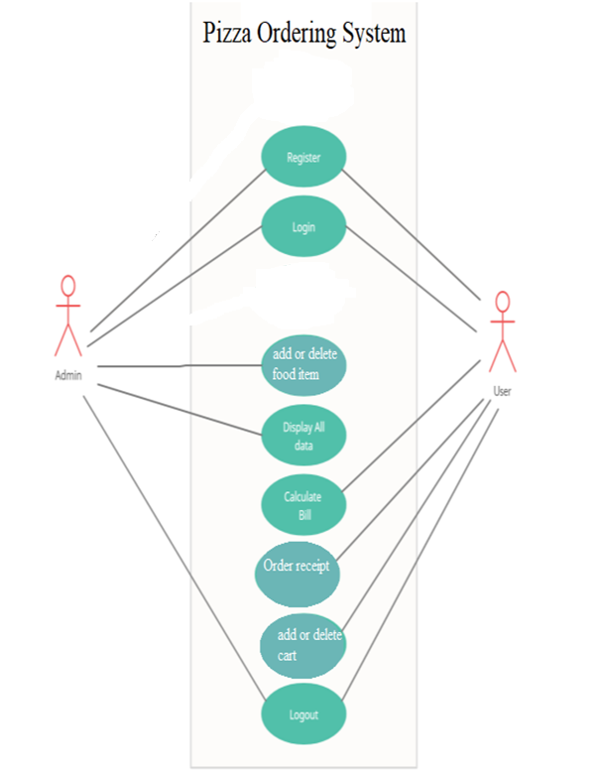
ER Diagram

Slide 11
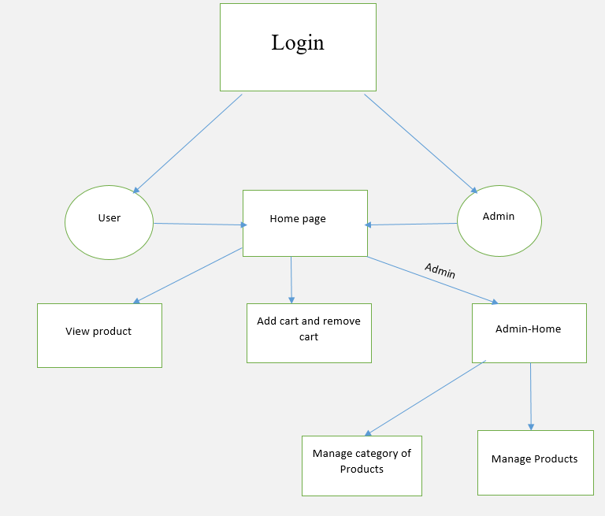
Data Flow Diagram

Slide 12
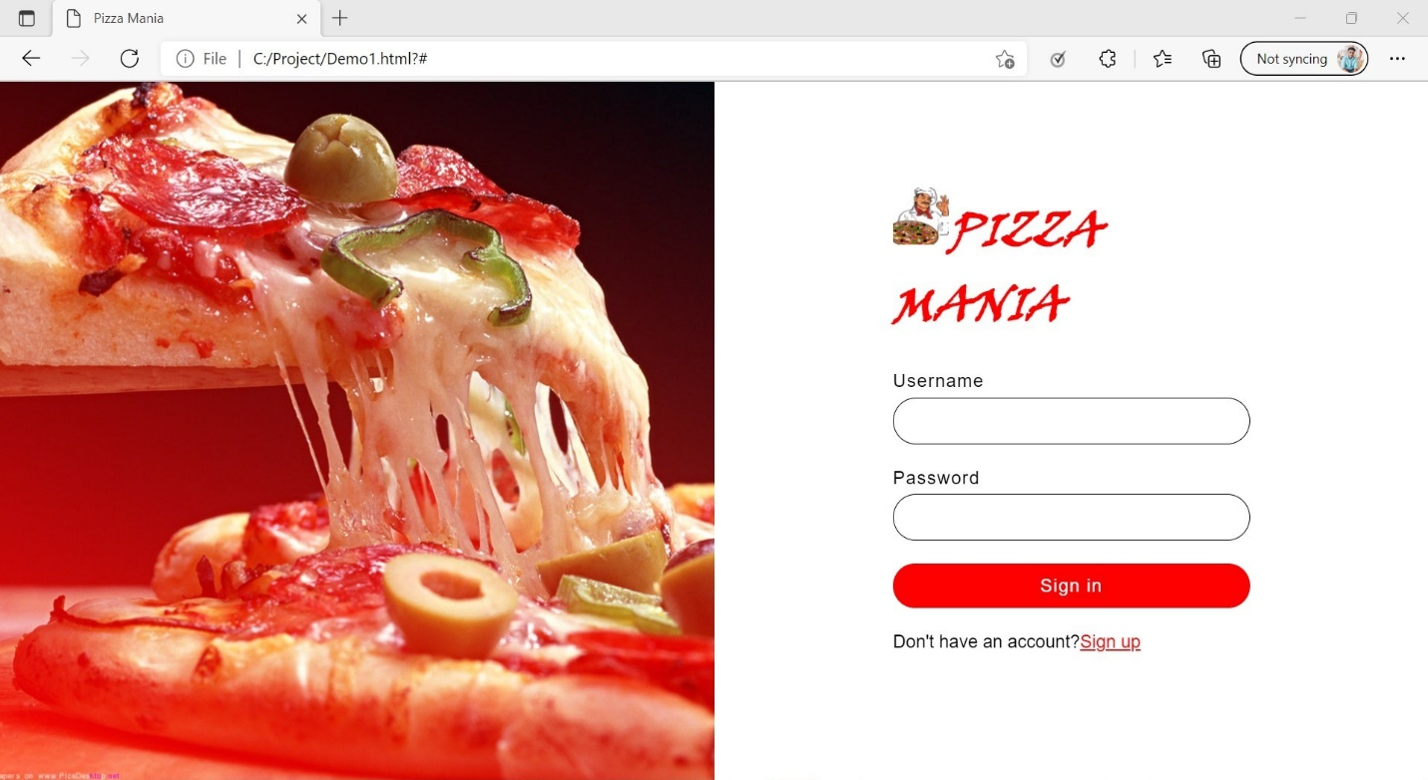
Login Page

Slide 13
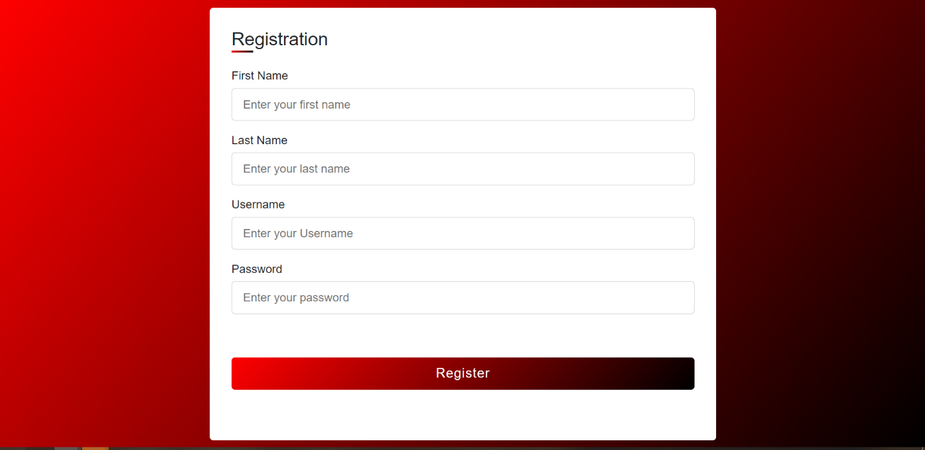
Registration Page

Slide 14
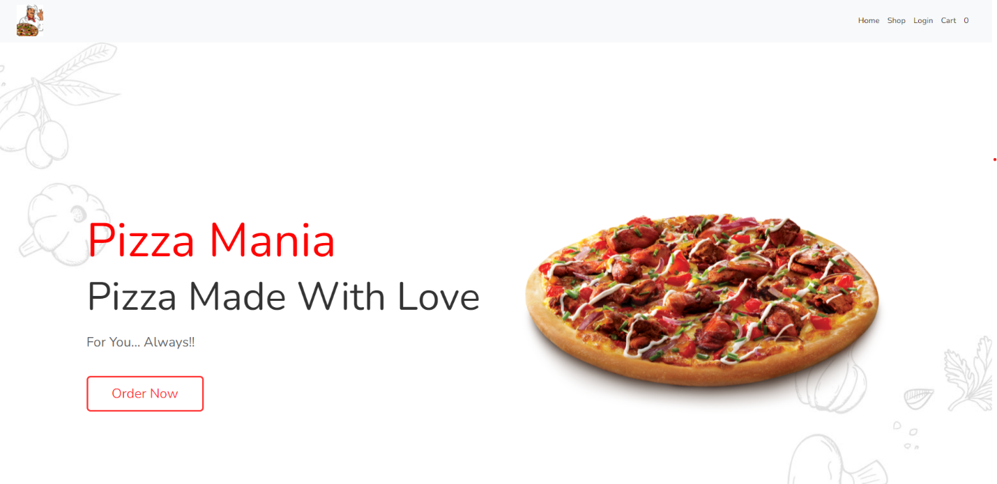
Home Page

Slide 15
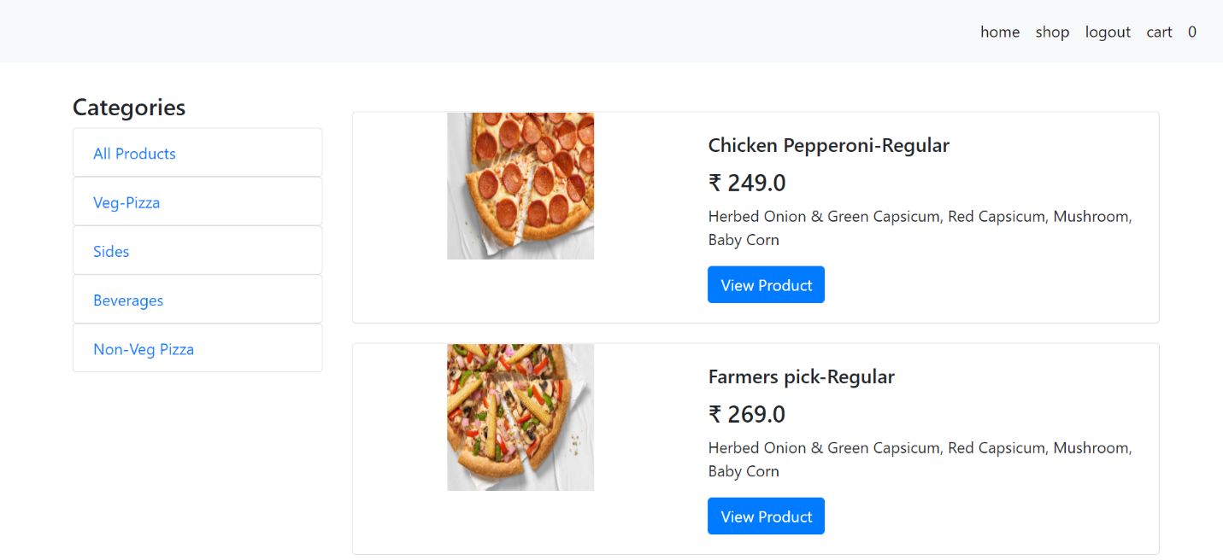
Shop Page

Slide 16
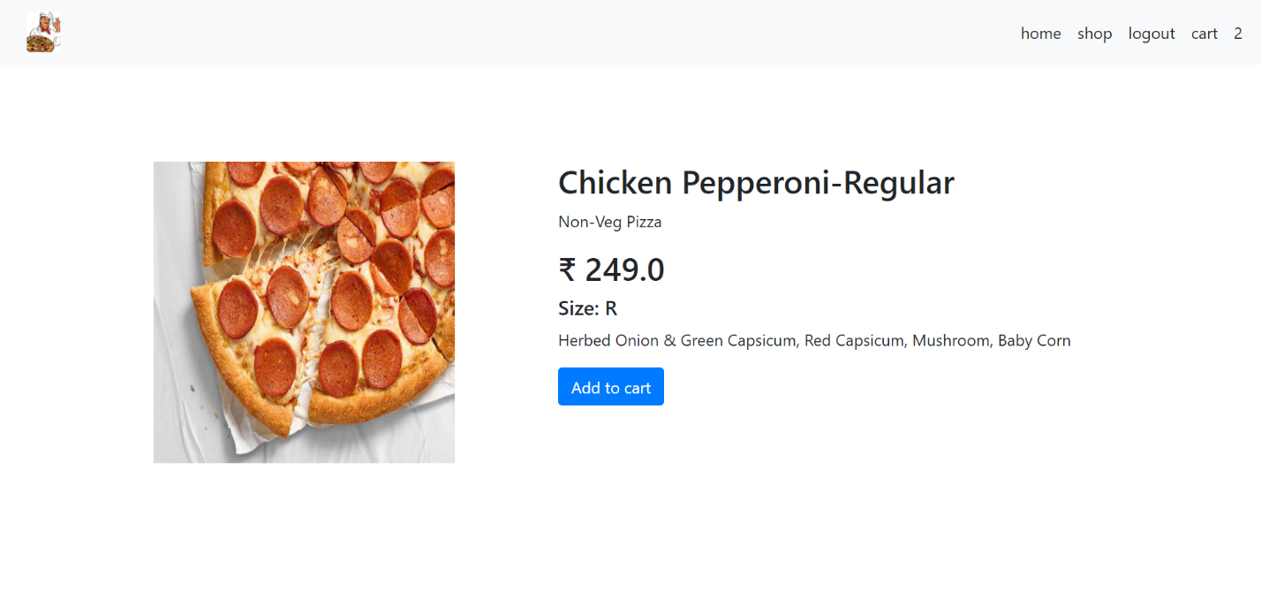
View Product Page

Slide 17
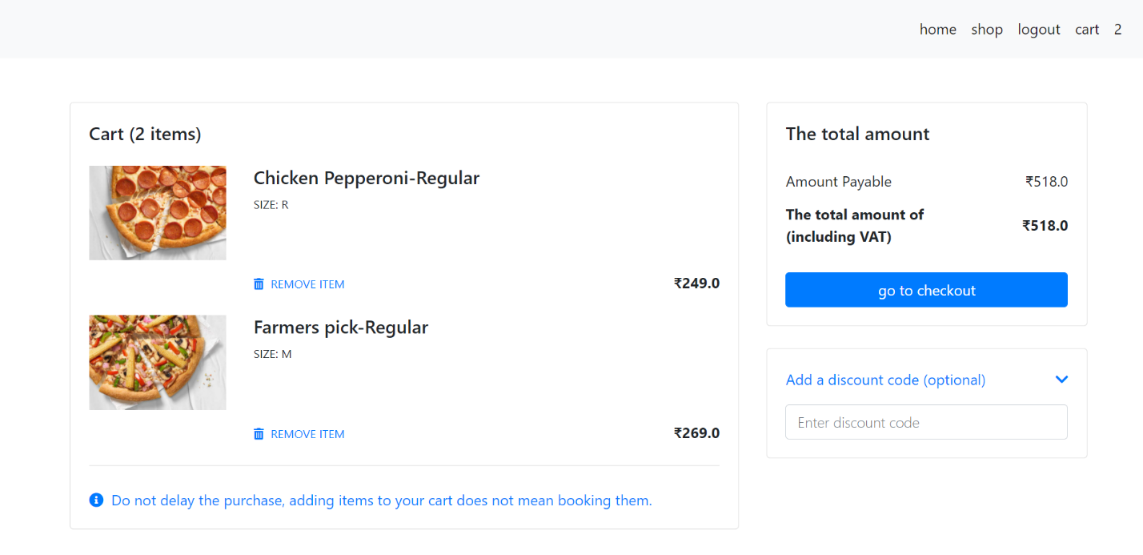
Cart Page

Slide 18
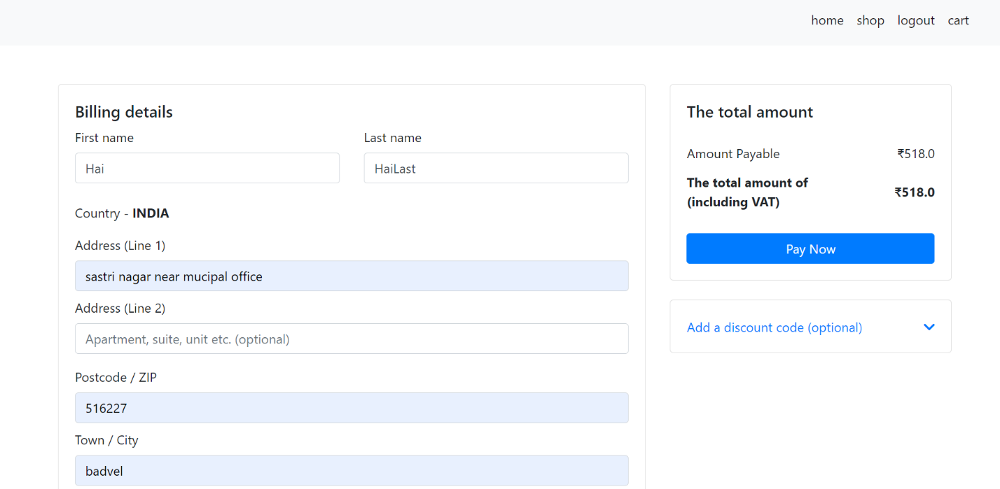
Check Out Page

Slide 19
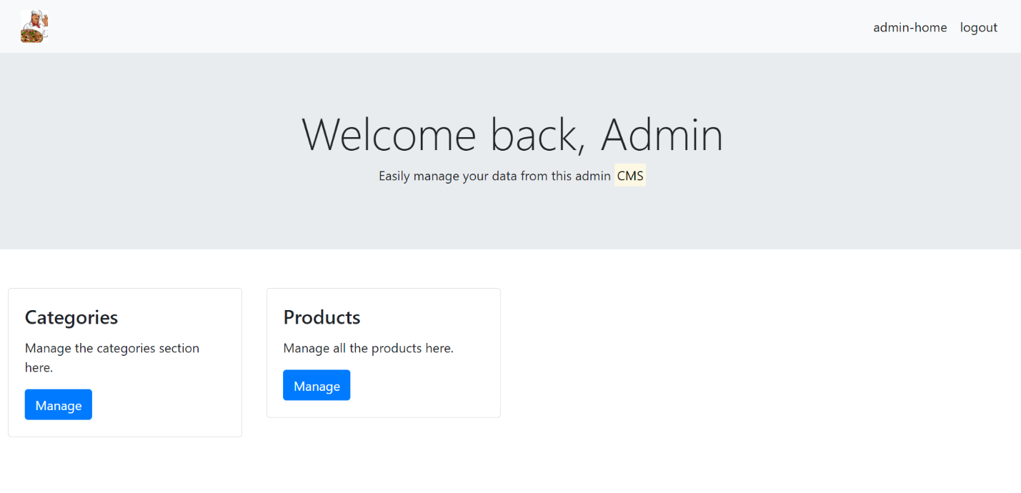
Admin Home

Slide 20
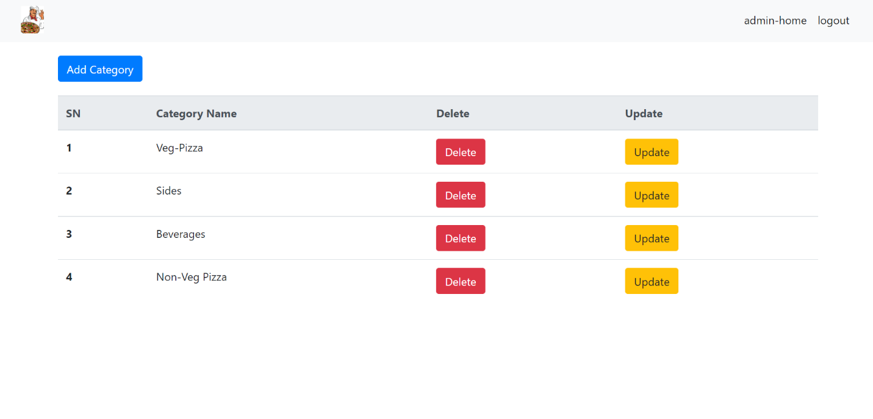
View, Update, Delete- Category(Admin)

Slide 21
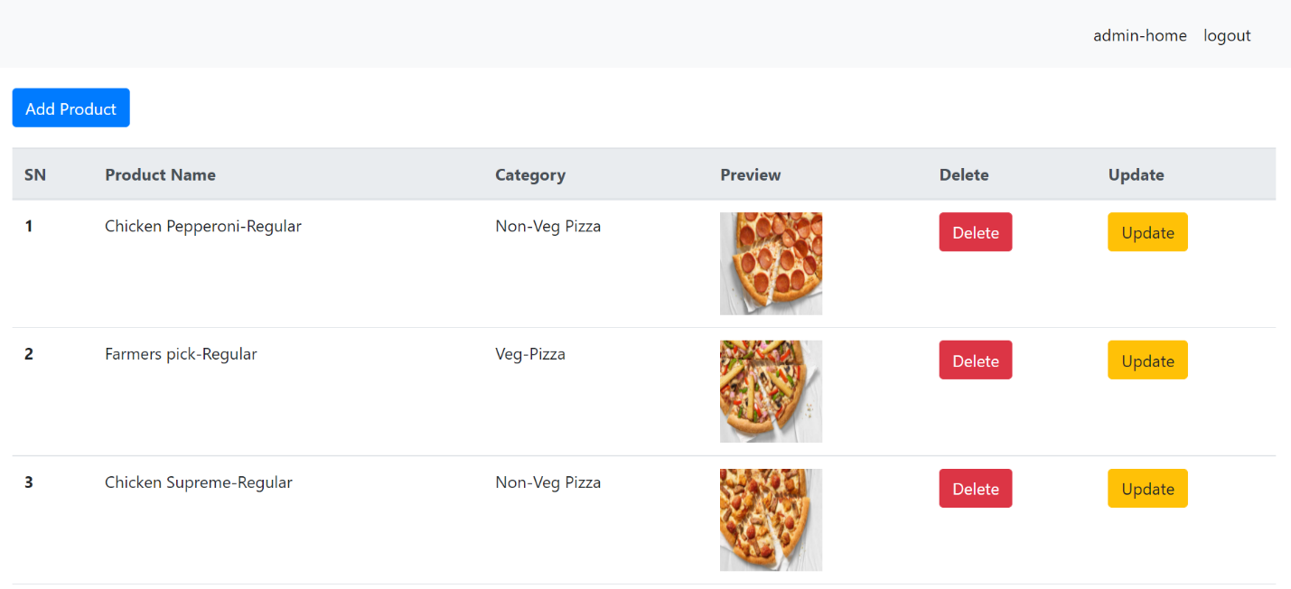
View, Update, Delete- Product(Admin)

Slide 22
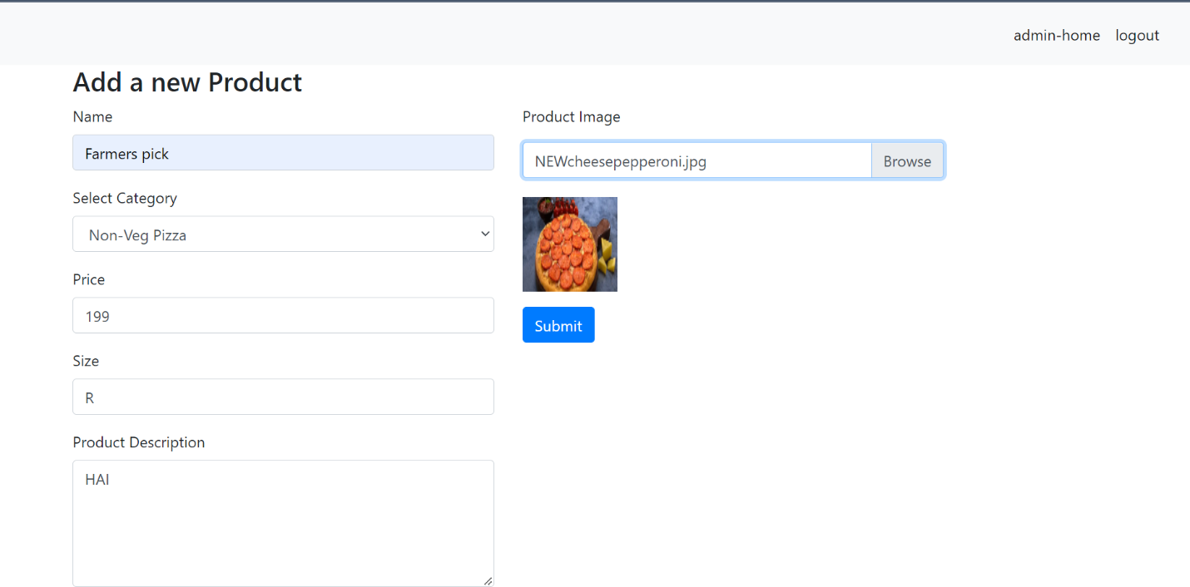
Add- Product(Admin)

Slide 23
THANK YOU

